Slide 1
Image Processing and Pattern Recognition (IPPR):
(Lecture 5)

Slide 2
Contents
In this lecture we will look at more spatial filtering techniques
  Spatial filtering refresher
  Sharpening filters
    1st derivative filters
    2nd derivative filters
  Combining filtering techniques

Slide 3
Spatial Filtering Refresher
Origin
x
a
b
c
r
s
t
d
e
f
*
u
v
w
g
h
i
x
y
z
Original Image Pixels
Filter
Simple 3*3
Neighbourhood
e
3*3 Filter
e_{processed} = v*e +
r*a + s*b + t*c +
u*d + w*f +
x*g + y*h + z*i
y
Image f (x, y)
The above is repeated for every pixel in the original image to generate the smoothed image

Slide 4
Sharpening Spatial Filters
Previously we have looked at smoothing filters which remove fine detail
Sharpening spatial filters seek to highlight fine detail
  Remove blurring from images
  Highlight edges
Sharpening filters are based on spatial differentiation

Slide 5
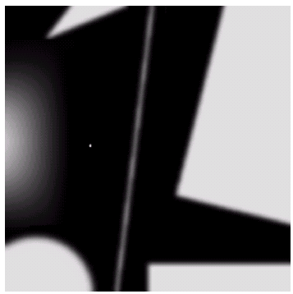

Spatial Differentiation
Differentiation measures the rate of change of a function
Let’s consider a simple 1 dimensional example
Images taken from Gonzalez & Woods, Digital Image Processing (2002)

Slide 6
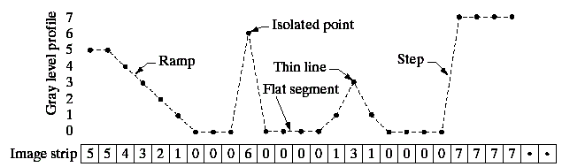
Spatial Differentiation
A
B
Images taken from Gonzalez & Woods, Digital Image Processing (2002)

Slide 7
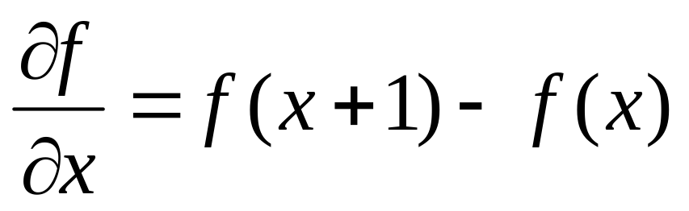
1st Derivative
The formula for the 1st derivative of a function is as follows:
It’s just the difference between subsequent values and measures the rate of change of the function

Slide 8
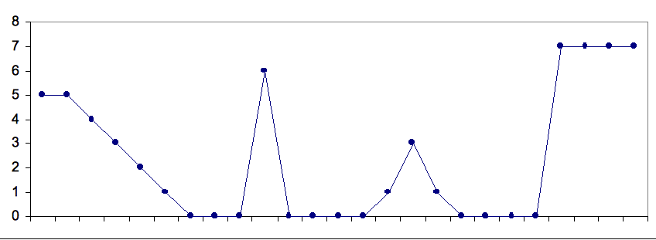
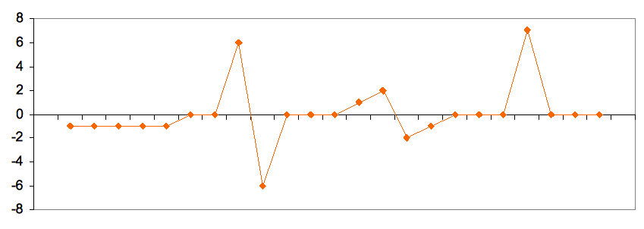
1st Derivative (cont…)
5 | 5 | 4 | 3 | 2 | 1 | 0 | 0 | 0 | 6 | 0 | 0 | 0 | 0 | 1 | 3 | 1 | 0 | 0 | 0 | 0 | 7 | 7 | 7 | 7
 | 0 | -1 | -1 | -1 | -1 | 0 | 0 | 6 | -6 | 0 | 0 | 0 | 1 | 2 | -2 | -1 | 0 | 0 | 0 | 7 | 0 | 0 | 0

Slide 9
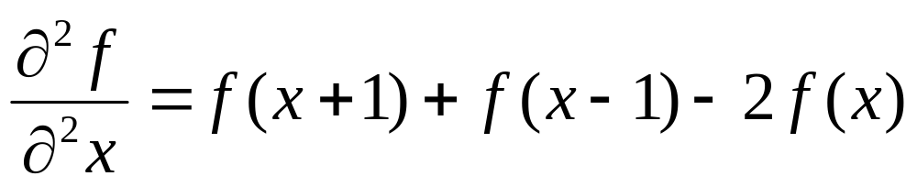
2nd Derivative
The formula for the 2nd derivative of a function is as follows:
Simply takes into account the values both before and after the current value

Slide 10
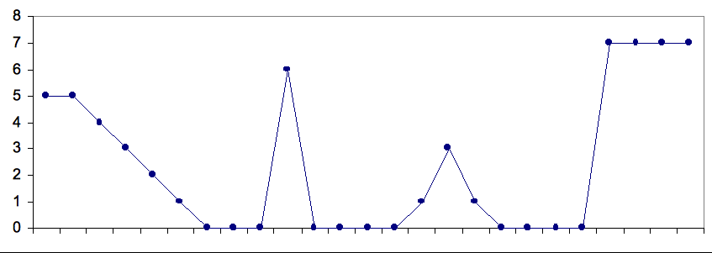
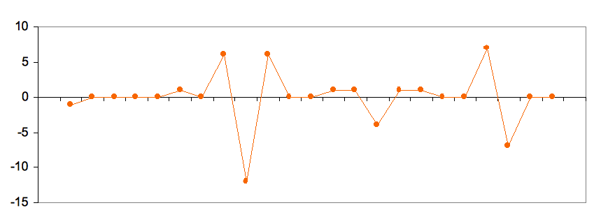
2nd Derivative (cont…)
5 | 5 | 4 | 3 | 2 | 1 | 0 | 0 | 0 | 6 | 0 | 0 | 0 | 0 | 1 | 3 | 1 | 0 | 0 | 0 | 0 | 7 | 7 | 7 | 7
 | -1 | 0 | 0 | 0 | 0 | 1 | 0 | 6 | -12 | 6 | 0 | 0 | 1 | 1 | -4 | 1 | 1 | 0 | 0 | 7 | -7 | 0 | 0

Slide 11
Using Second Derivatives For Image Enhancement
The 2nd derivative is more useful for image enhancement than the 1st derivative
  Stronger response to fine detail
  Simpler implementation
  We will come back to the 1st order derivative later on
The first sharpening filter we will look at is the Laplacian
  Isotropic
  One of the simplest sharpening filters
  We will look at a digital implementation

Slide 12
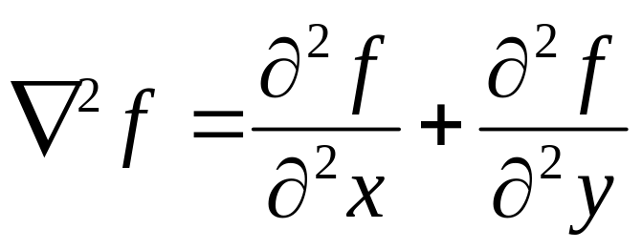
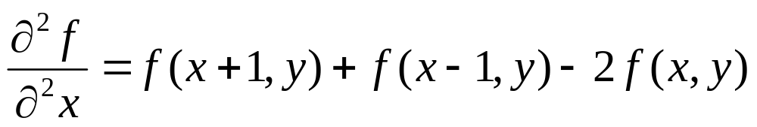
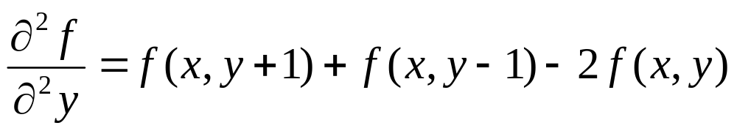
The Laplacian
The Laplacian is defined as follows:
where the partial 1st order derivative in the x direction is defined as follows:
and in the y direction as follows:

Slide 13
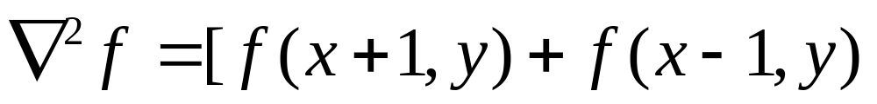
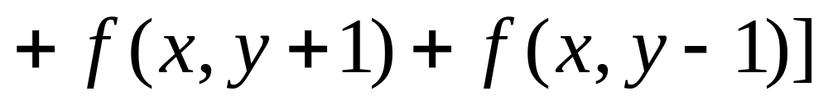
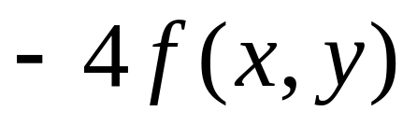
The Laplacian (cont…)
So, the Laplacian can be given as follows:
We can easily build a filter based on this
0
1
0
1
-4
1
0
1
0

Slide 14
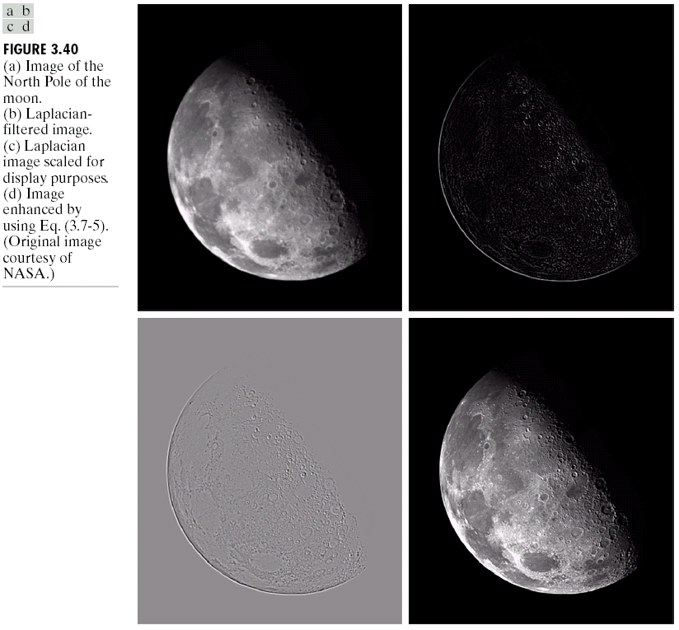
The Laplacian (cont…)
Applying the Laplacian to an image we get a new image that highlights edges and other discontinuities
Images taken from Gonzalez & Woods, Digital Image Processing (2002)
Original
Image
Laplacian
Filtered Image
Laplacian
Filtered Image
Scaled for Display

Slide 15
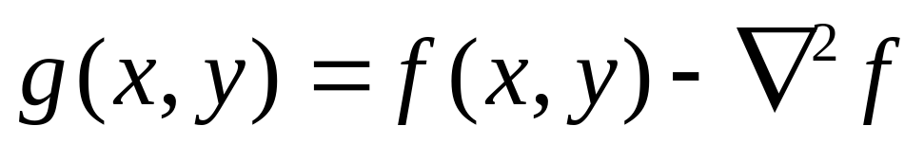
But That Is Not Very Enhanced!
The result of a Laplacian filtering is not an enhanced image
We have to do more work in order to get our final image
Subtract the Laplacian result from the original image to generate our final sharpened enhanced image
Images taken from Gonzalez & Woods, Digital Image Processing (2002)
Laplacian
Filtered Image
Scaled for Display

Slide 16
Laplacian Image Enhancement
-
=
Original
Image
Laplacian
Filtered Image
Sharpened
Image
Images taken from Gonzalez & Woods, Digital Image Processing (2002)
In the final sharpened image edges and fine detail are much more obvious

Slide 17
Laplacian Image Enhancement
Images taken from Gonzalez & Woods, Digital Image Processing (2002)

Slide 18
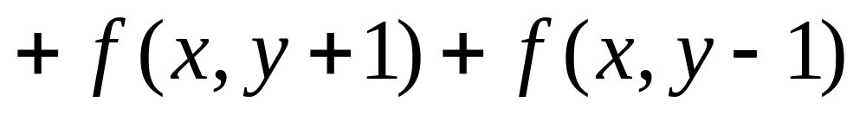
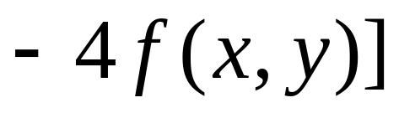
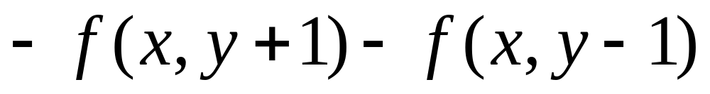
Simplified Image Enhancement
The entire enhancement can be combined into a single filtering operation

Slide 19
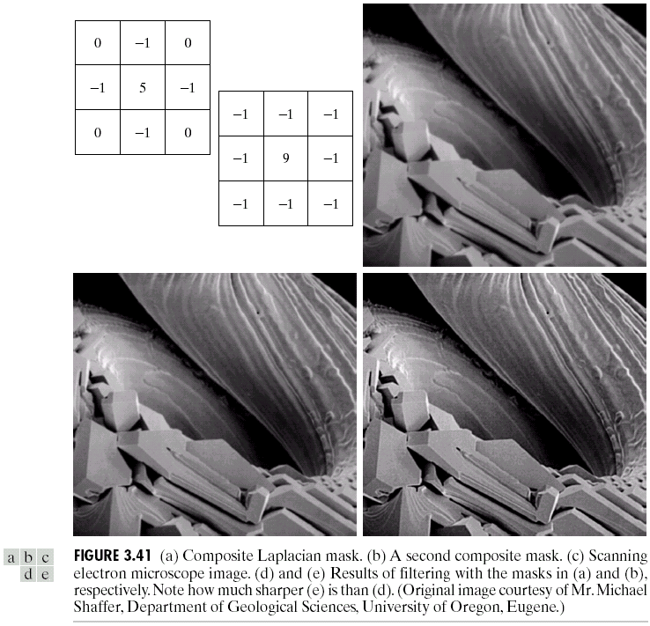
Simplified Image Enhancement (cont…)
This gives us a new filter which does the whole job for us in one step
0
-1
0
-1
5
-1
Images taken from Gonzalez & Woods, Digital Image Processing (2002)
0
-1
0

Slide 20
Simplified Image Enhancement (cont…)
Images taken from Gonzalez & Woods, Digital Image Processing (2002)

Slide 21
Variants On The Simple Laplacian
There are lots of slightly different versions of the Laplacian that can be used:
0
1
0
1
1
1
Simple
Laplacian
Variant of
Laplacian
1
-4
1
1
-8
1
0
1
0
1
1
1
Images taken from Gonzalez & Woods, Digital Image Processing (2002)
-1
-1
-1
-1
9
-1
-1
-1
-1

Slide 22
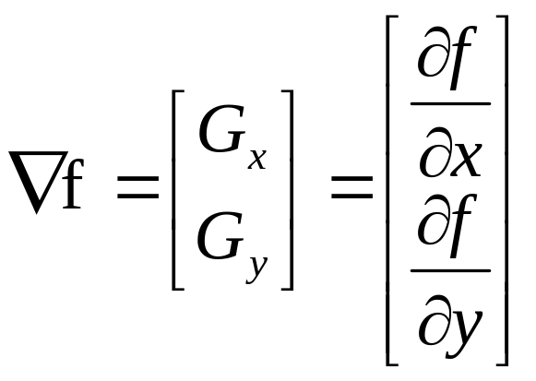
1st Derivative Filtering
Implementing 1st derivative filters is difficult in practice
For a function f(x, y) the gradient of f at coordinates (x, y) is given as the column vector:

Slide 23
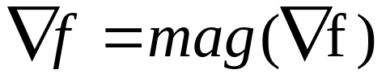
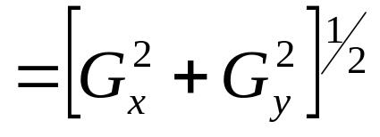
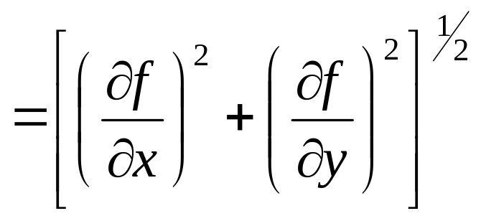
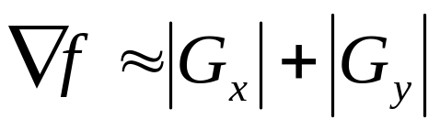
1st Derivative Filtering (cont…)
The magnitude of this vector is given by:
For practical reasons this can be simplified as:

Slide 24
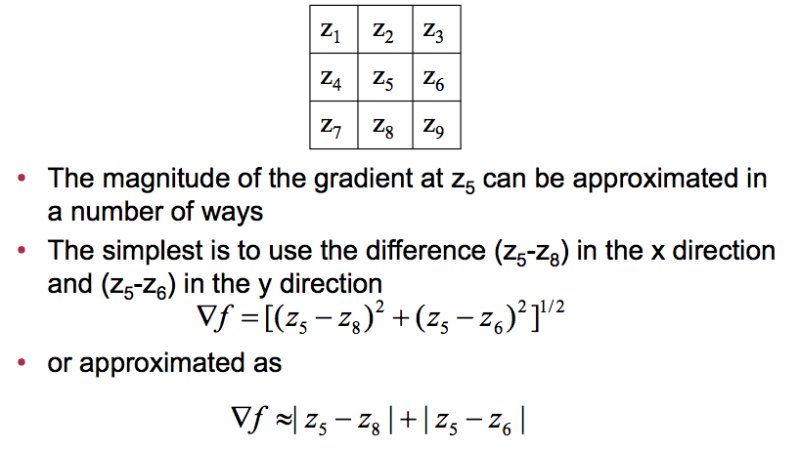
1st Derivative Filtering (cont…)

Slide 25
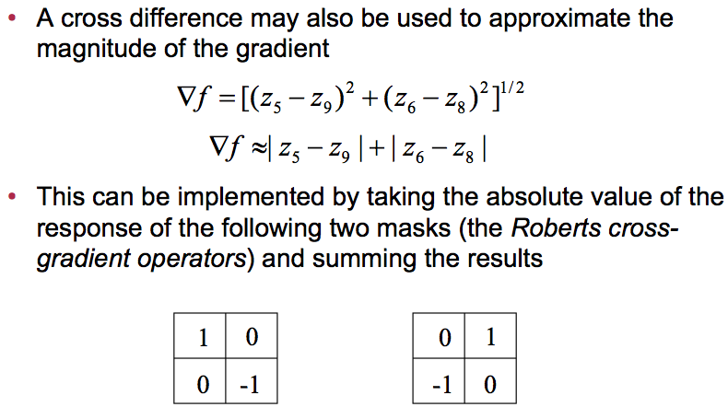
1st Derivative Filtering (cont…)

Slide 26
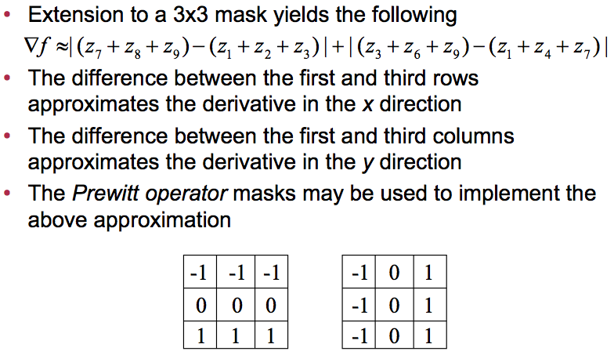
1st Derivative Filtering (cont…)

Slide 27
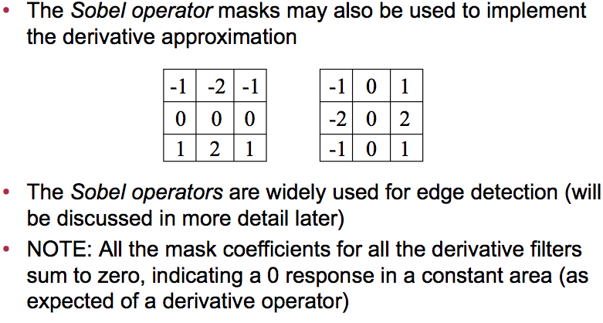
1st Derivative Filtering (cont…)

Slide 28
Sobel Operators
Based on the previous equations we can derive the Sobel Operators
To filter an image it is filtered using both operators the results of which are added together
-1
-2
-1
-1
0
1
0
0
0
-2
0
2
1
2
1
-1
0
1

Slide 29
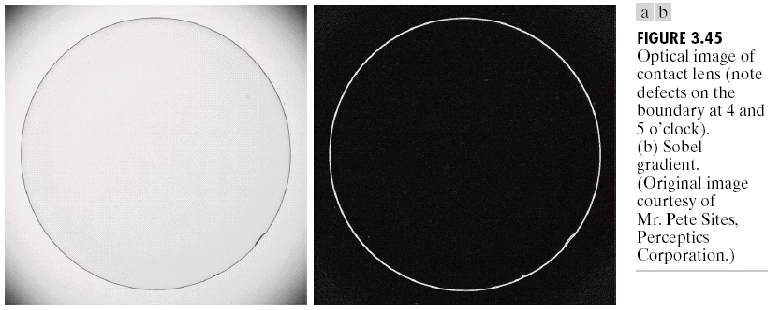
Sobel Example
Sobel filters are typically used for edge detection
An image of a contact lens which is enhanced in order to make defects (at four and five o’clock in the image) more obvious
Images taken from Gonzalez & Woods, Digital Image Processing (2002)

Slide 30
1st & 2nd Derivatives
Comparing the 1st and 2nd derivatives we can conclude the following:
  1st order derivatives generally produce thicker edges
  2nd order derivatives have a stronger response to fine detail e.g. thin lines
  1st order derivatives have stronger response to grey level step
  2nd order derivatives produce a double response at step changes in grey level

Slide 31
Summary
In this lecture we looked at:
  Sharpening filters
    1st derivative filters
    2nd derivative filters
  Combining filtering techniques

Slide 32
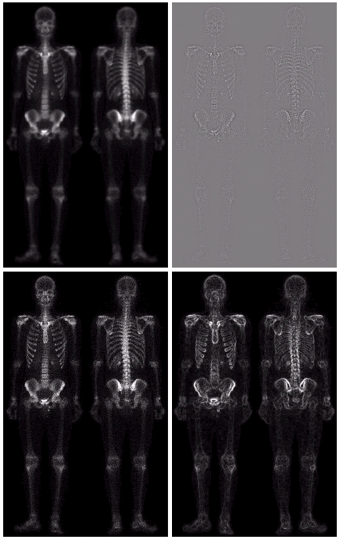
Combining Spatial Enhancement Methods
Successful image enhancement is typically not achieved using a single operation
Rather we combine a range of techniques in order to achieve a final result
This example will focus on enhancing the bone scan to the right
Images taken from Gonzalez & Woods, Digital Image Processing (2002)

Slide 33
Combining Spatial Enhancement Methods (cont…)
(a)
Images taken from Gonzalez & Woods, Digital Image Processing (2002)
Laplacian filter of bone scan (a)
(b)
Sharpened version of bone scan achieved by subtracting (a) and (b)
(c)
Sobel filter of bone scan (a)
(d)

Slide 34
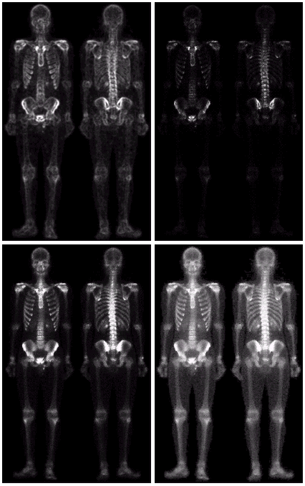
Combining Spatial Enhancement Methods (cont…)
Result of applying a power-law trans. to (g)
(h)
Sharpened image which is sum of (a) and (f)
(g)
The product of (c) and (e) which will be used as a mask
(f)
(e)
Images taken from Gonzalez & Woods, Digital Image Processing (2002)
Image (d) smoothed with a 5*5 averaging filter

Slide 35
Combining Spatial Enhancement Methods (cont…)
Compare the original and final images
Images taken from Gonzalez & Woods, Digital Image Processing (2002)

